Slide 1
Heart Disease Data
TEAM 8:
Shreya wahi
Saikiran KARRA
Akanksha

Slide 2
Our Data!
The provided data set gives the information of the presence or absence of heart disease. Various measures such as age, sex, chest pain type, resting blood pressure, serum cholesterol, fasting blood sugar, ECG results, maximum attained heart rate, exercise induced angina, number of major blood vessels ad level of thalassemia are given.
s.no | variables | data type
1 | Age | Numerical
2 | Sex | Binary
3 | Chest Pain | Nominal
4 | resting BP | Numerical
5 | Serum Cholesterol | Numerical
6 | Fasting Bl. Sugar | Binary
7 | ECG | Nominal
8 | Max heart rate | Numerical
9 | Exian | Binary
10 | Old Peak | Numerical
11 | Slope | Nominal
12 | Vessel | Nominal
13 | Thalassemia | Nominal
14 | Class (study var) | Binary

Slide 3
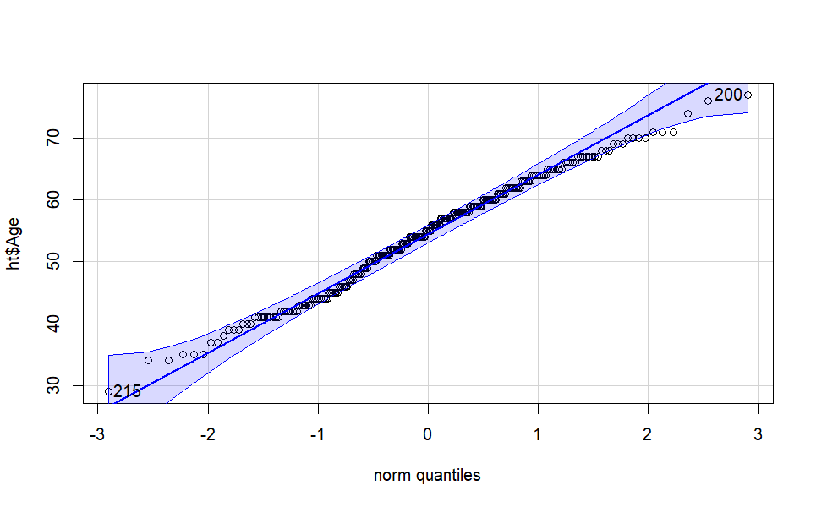
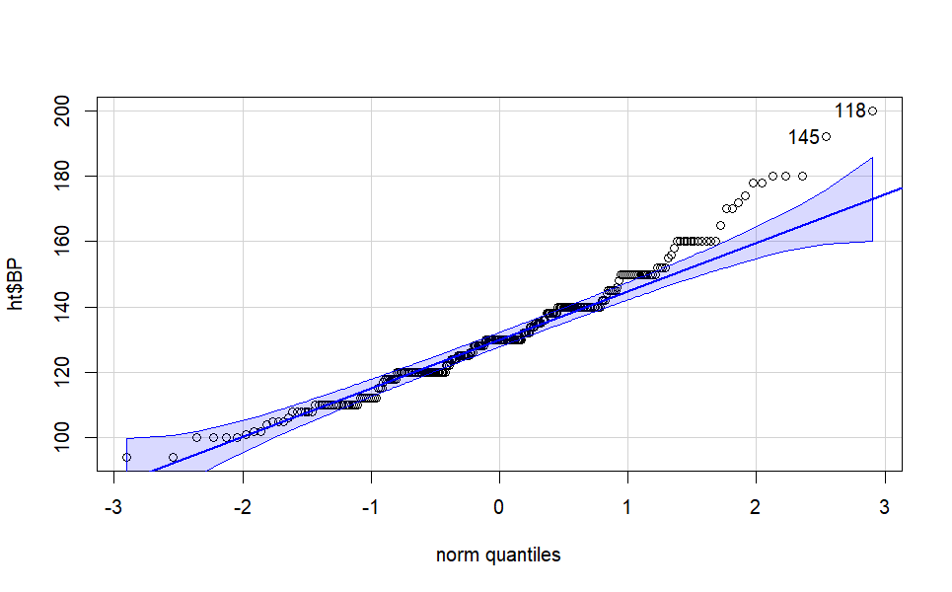
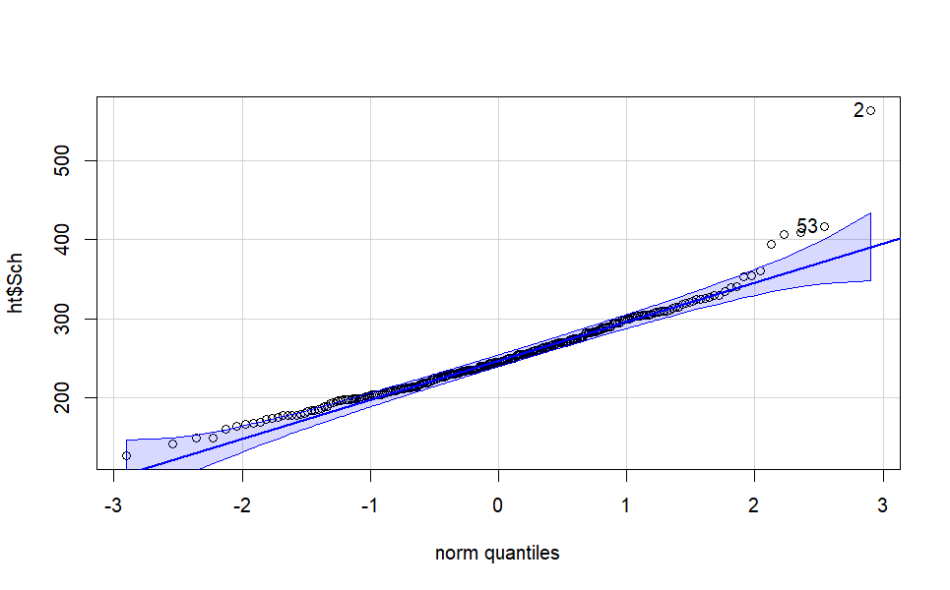
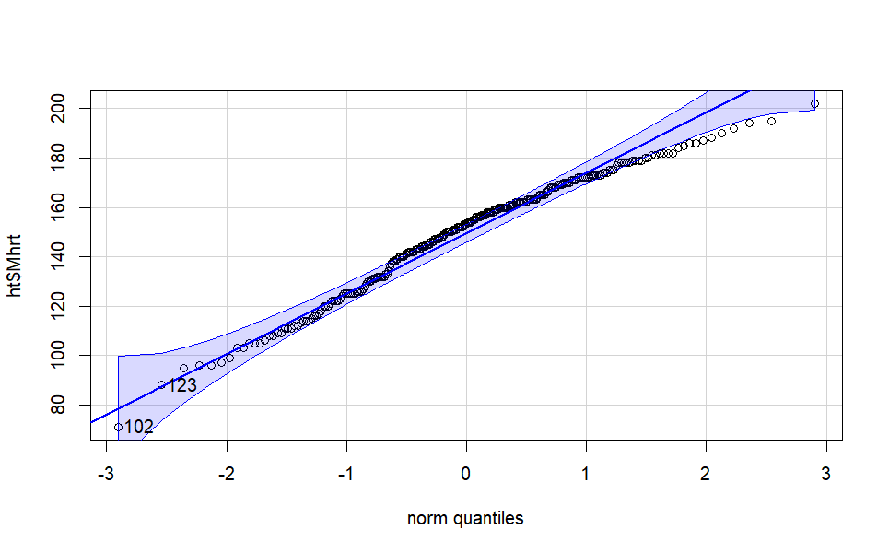
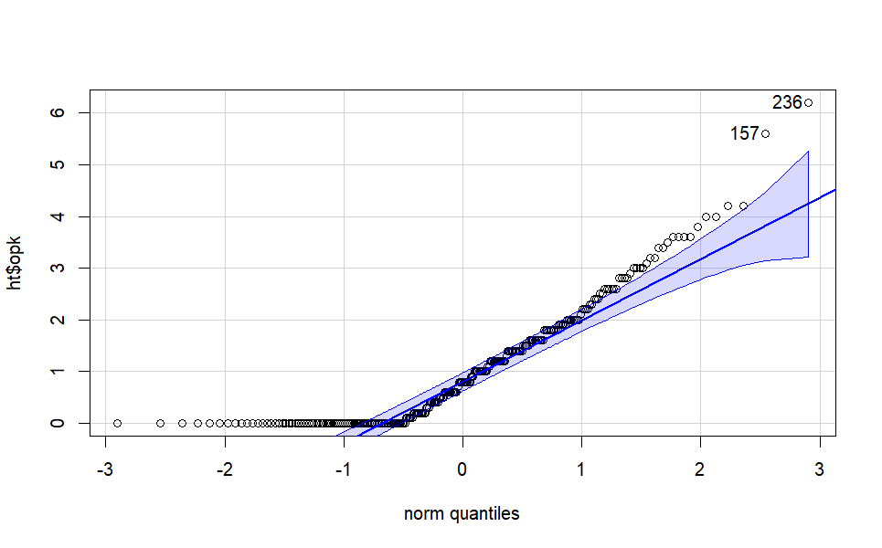
Checking Distribution.
We proceed by first checking the normality for the continuous variables. We use qqplots and Shapiro-Wilk Tests.
For all the numerical variables, i.e. Age, BP, Serum Cholesterol, max. heart rate and Old peak , the p value of Shapiro Wilk test is below 0.05. Hence we reject the null hypothesis and conclude that the variables are not normal.
We moved ahead with distribution free tests.

Slide 4
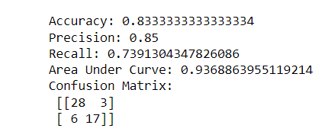
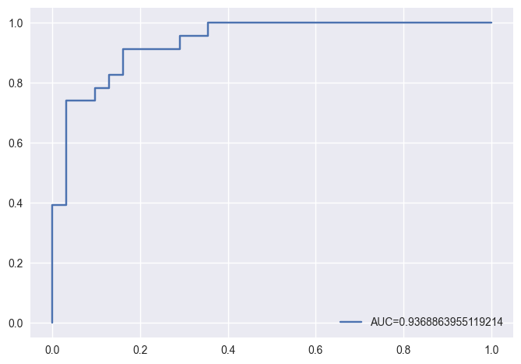
MODEL FITTING : Logistic Regression
Taking the Class as the response variables , we have fit a logistic regression model over all the independent variables.
We have divided the data into 80-20 train-test data and have fit the model by using dummy variables for the independent variables that had categories more than 2.
INTERPRETATION: The accuracy of our model is 0.833(correct predictions over total predictions). With Precision of 0.85(true positives over all true predictions) and Recall value 0.73 (true positives over all positives).
Our model gives a AUC of 0.93688 which shows that the model is a good fit.
ROC – AUC curve

Slide 5
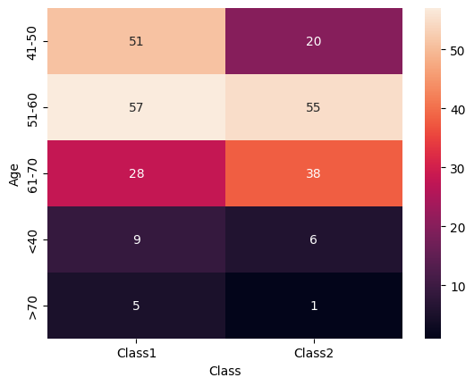
Identifying the groups most prone to Heart Disease.
Pearson's Chi-squared test data: df_age
X-squared = 15.207, df= 4, p-value = 0.00429
Our aim is to identify the ranges in our numerical variables which are the most prone to heart disease. we have use chi-square test for the same.
For Age: We have grouped the ages and created a contingency table for the number of diseased and healthy patients in each age group.
We observe that there are 57.57% patients in age group 61-70 years who have heart disease followed by 49.01% in 51-60 years and 28.16% in 41-50 years.
Since the p-value of chi-square test is less than 0.05, we conclude that there is a significant association between age and heart disease.
From the percentages , we can safely conclude that as a person grows older the risk of heart disease increases and hence older people are more prone to the heart disease.

Slide 6
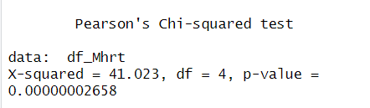
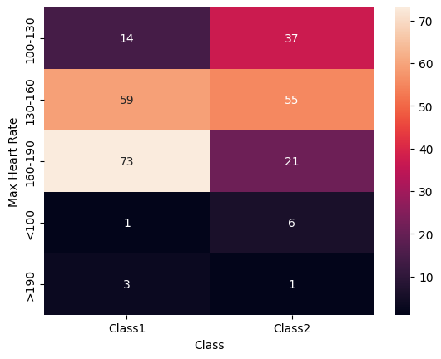
Since the p-value of chi-square test is less than 0.05, we conclude that there is a significant association between heart rate and heart disease.
From the percentages , we can conclude that a person with heart rate between 130 – 160 and under 130 are prone to heart disease.
*But according to our theoretical knowledge this outcome feels wrong.
For Heart Rate : We have grouped the ages and created a contingency table for the number of diseased and healthy patients in each age group.
We observe that there are 85% patients with heart rate below 100 who have heart disease followed by 72% with heart rate between 130-160.

Slide 7
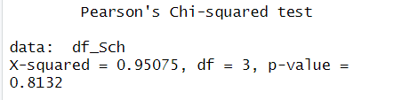
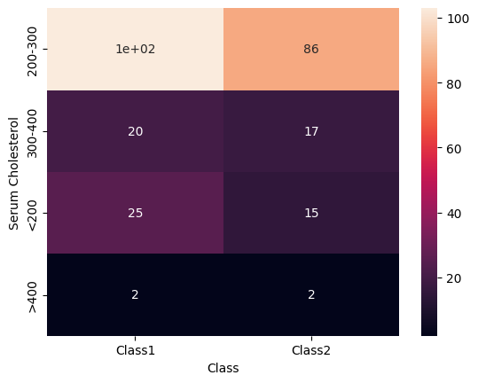
For Serum Cholesterol: We have grouped the levels of serum cholesterol and created a contingency table for the number of diseased and healthy patients in each age group.
We observe that there are 50% patients having heart disease with serum cholesterol levels greater than 400 followed by 45% patients with serum cholesterol levels from 200-400.
By looking at the p value for chi-square test (>0.05) we can accept the null hypothesis and conclude that there is no association between serum cholesterol levels and heart disease.
But from the proportions we can say that patients with higher serum cholesterol levels are prone towards having heart diseases.

Slide 8
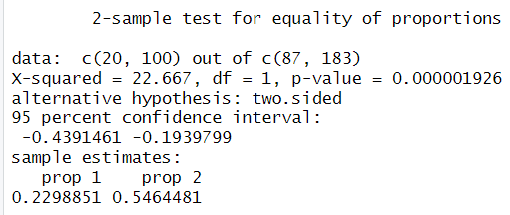
Checking for Significant Proportions.
Gender Proportions:
We tested for the difference of proportions of males and females having heart disease. The contingency table is given as :
Interpretation: from the 2 sample test for proportionality , p values is < 0.05, hence we can imply that the proportions vary significantly and we can say that heart disease is more prone to males than females.

Slide 9
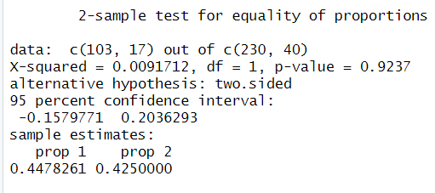
Fasting Blood Sugar Proportions:
We tested for the difference of proportions for the patients having blood sugar level greater and less than 120 having heart disease. The contingency table is given as :
Interpretation: from the 2 sample test for proportionality , p values is > 0.05, hence we can imply that the proportions do not vary significantly.

Slide 10
THANK YOU.

